Slide 1
Architecture
(DBMS)
Notes:
‹#›

Slide 2
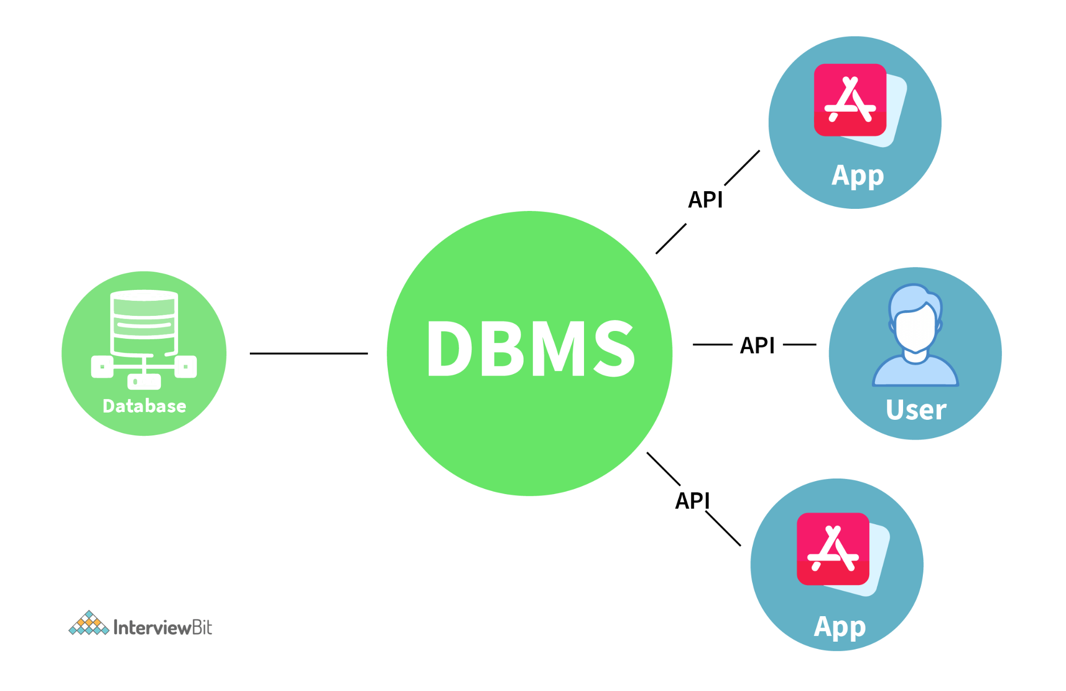
Introduction
DBMS stands for Database Management System.
DBMS is a software system for creating, organizing and managing the database.
It provides an environment to the user to perform operations on the database for creation, insertion, deletion, updating and retrieval of data.

Slide 3

What is Data ?
A collection of raw facts and figures.
Raw facts that can be recorded.
Raw material that can be processed by any computing machine.
A collection of facts from which conclusions may be drawn.
Data can be represented in the form of: numbers and words which can be stored in computer’s language. i.e. Rakesh, Sohan ,001,

Slide 4

What is Information?
Systematic and meaningful form of data.
Knowledge acquired through study or experience.
Information helps human beings in their decision making.

Slide 5
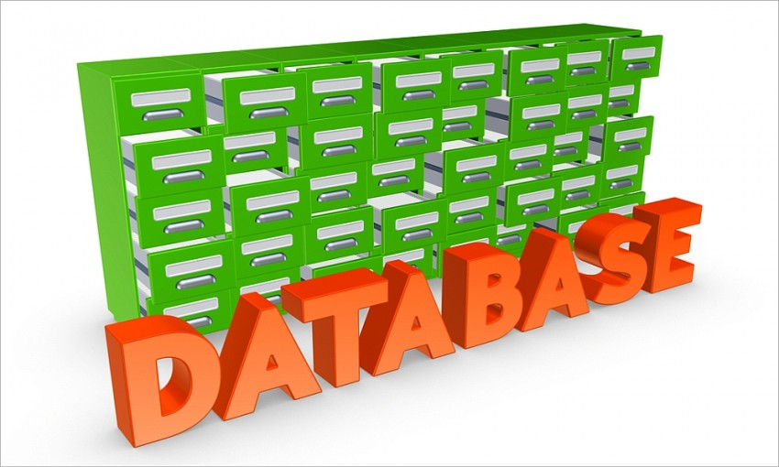
Database
A safekeeping of logically related and similar data.
An organized collection of related information so that it can easily be accessed, managed and updated.
E.g.: Dictionary Airline Database
Student Database Library
Railways
Timetable
YouTube

Slide 6
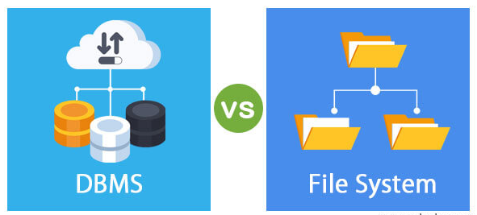
Limitation of File System+OS
Difficult to access the data from database
To high I/O cost
Concurrency level
Security

Slide 7
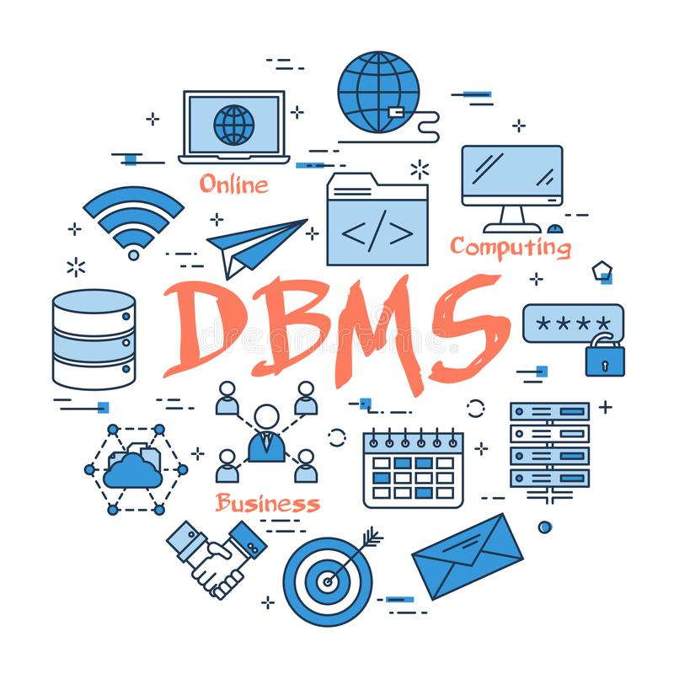
What is DBMS ?
A set of programs to access the interrelated data.
DBMS contains information about a particular enterprise.
Computerized record keeping system.
Provides convenient environment to user to perform operations:Creation, Insertion, Deletion, Updating & Retrieval of information

Slide 8
Limitation of DBMS
Not suitable for small DBMS
Costly

Slide 9
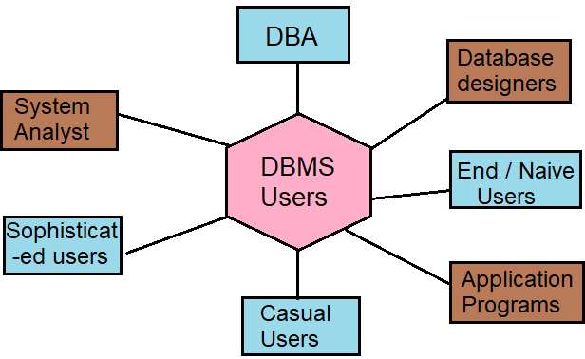
Database Users
DBA Staff
Casual Users
Application Programmers
Parametric Users (Naive users)
Sophisticated Users
Specialized Users
Notes:
Naive users: Are unsophisticated users, they do not want to know about internal working of system that how the data saves in database. They directly use the application. Suppose that anyone want to know balance in his account or want to transfersome money, then he login and check their balance and transfer. He does not want to know about internal working that how money actually transferred.
Application programmers: Are computer programmers, who uses different tools to write application and user interfaces. By using these tools they can directly generate forms and reports.
Sophisticated users: These users are database programmer who writes SQL queries. These programmer works with database objects. They interact with the database through structured query language.
Specialized users: These are should have sound knowledge of DBMS because they write special database application programs. They are the developers who develop the complex programs according to the requirement.

Slide 10
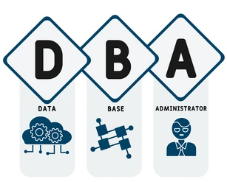
Database Administrator (DBA)
A person who has central control over the system is called a database administrator (DBA). Functions of a DBA include:
Schema definition
Storage structure and access-method definition
Schema and physical-organization modification
Granting of authorization for data access
Routine maintenance
Periodically backing up the database
Ensuring that enough free disk space is available for normal operations, and upgrading disk space as required
Monitoring jobs running on the database

Slide 11
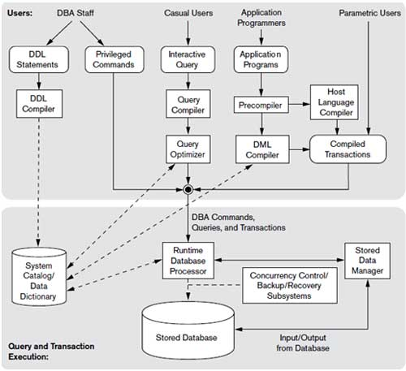
DBMS Componet Modules

Slide 12
Query Processor
The query processor components include:
DDL interpreter -- interprets DDL statements and records the definitions in the data dictionary.
DML compiler -- translates DML statements in a query language into an evaluation plan consisting of low-level instructions that the query evaluation engine understands.
The DML compiler performs query optimization; that is, it picks the lowest cost evaluation plan from among the various alternatives.
Query evaluation engine -- executes low-level instructions generated by the DML compiler.

Slide 13
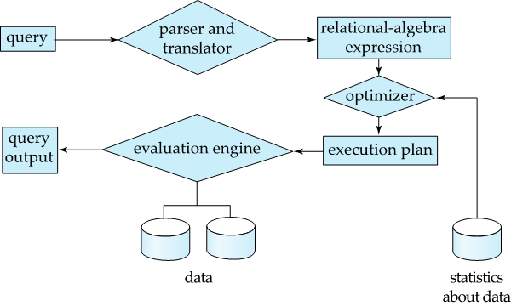
Query Processing
Parsing and translation
Optimization
Evaluation

Slide 14
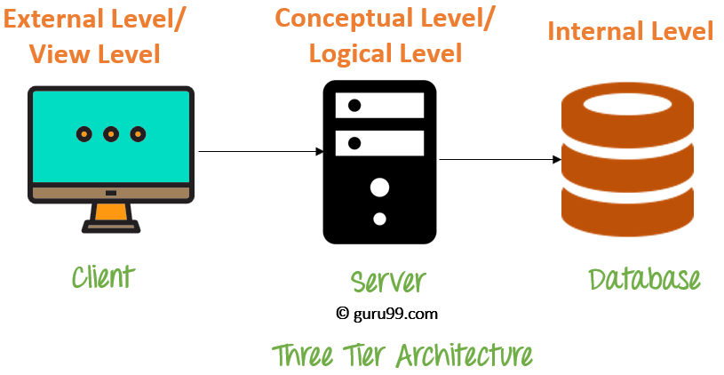
Three levels of Architecture
Three level architecture is also called ANSI/SPARC architecture or three schema architecture
This framework is used for describing the structure of specific database systems (small systems may not support all aspects of the architecture)
In this architecture the database schemas can be defined at three levels explained in next slide

Slide 15
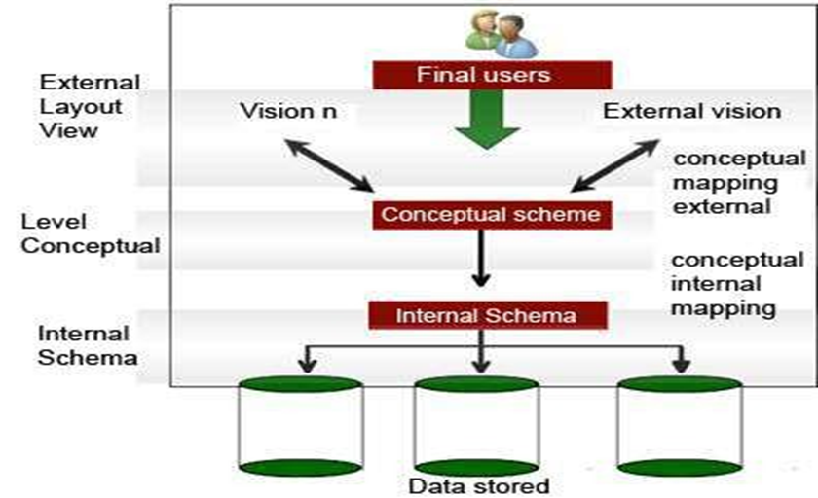
Three levels of Architecture

Slide 16
External View
Highest or Top level of data abstraction ( No knowledge of DBMS S/W and H/W or physical storage).
This level is concerned with the user.
Each external schema describes the part of the database that a particular user is interested in and hides the rest of the database from user.
There can be n number of external views for database where n is the number of users.
For example, a accounts department may only be interested in the student fee details. It would not be expected to have any interest in the personal information about students.

Slide 17
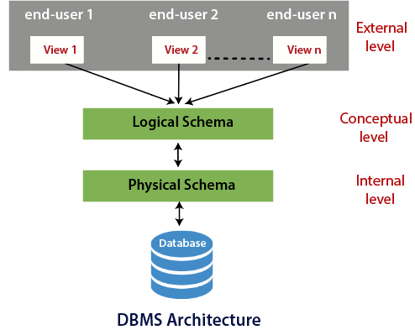
Conceptual View
This level is in between the user level and physical storage view.
There is only one conceptual view for single database.
It hides the details of physical storage structures and concentrates on describing entities, data types, relationships, user operations, and constraints.

Slide 18
Internal View
It is the lowest level of data abstraction. (it has the knowledge about s/w and h/w)
At this level, it keeps the information about the actual representation of the entire database i.e. the actual storage of the data on the disk in the form of records or blocks.
It is close to the physical storage method.
The internal view is the view that tells us what data is stored in the database and how. At least the following aspects are considered at this level: Storage allocation, Access paths etc.
The internal view does not deal with the physical devices directly. Instead it views a physical device as a collection of physical pages and allocates space in terms of logical pages.

Slide 19
Three levels of Architecture
Internal/physical level: Shows how data are stored inside the system. It is the closest level to the physical storage. This level talks about database implementation and describes such things as file organization and access paths of indexes, data compression and encryption techniques, and record placement
Conceptual/logical level: Deals with the modeling of the whole database. The conceptual schema of database is defined in this level
External level: This level models a user oriented description of part of the database. The views for individual users are defined by means of external schemas in this level

Slide 20
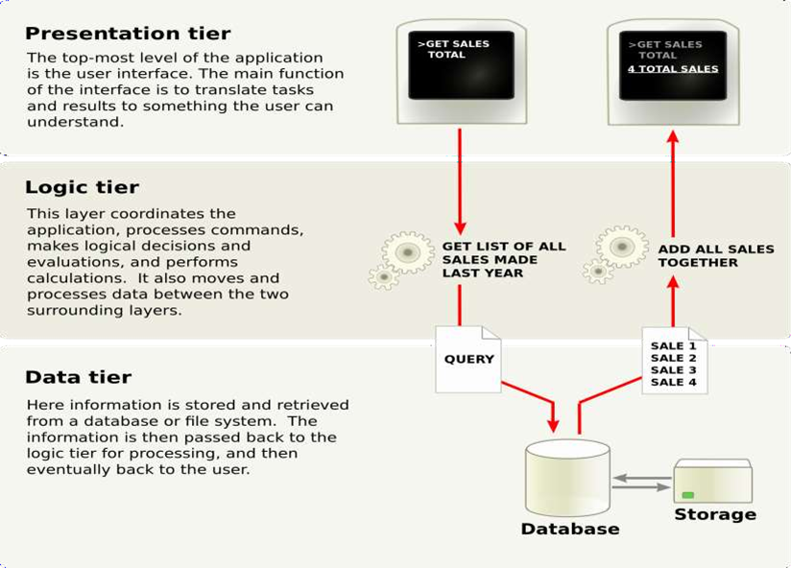
Working of three level architecture

Slide 21
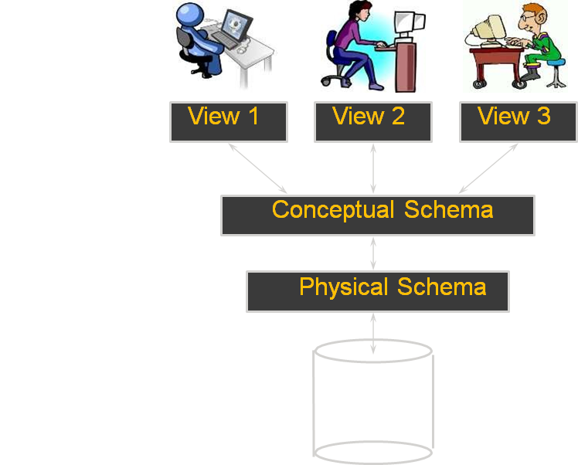
Level of DBMS Architecture :
DB

Slide 22
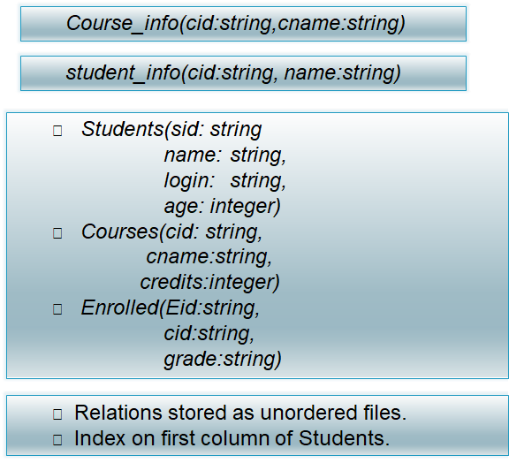
Example: University Database
External Schema (View-1)
External Schema (View-1)
Conceptual Schema
Physical Schema

Slide 23
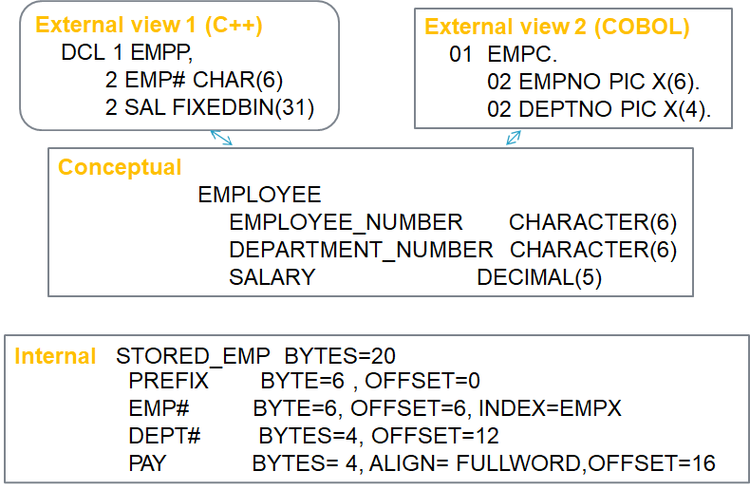
Example: employee database

Slide 24
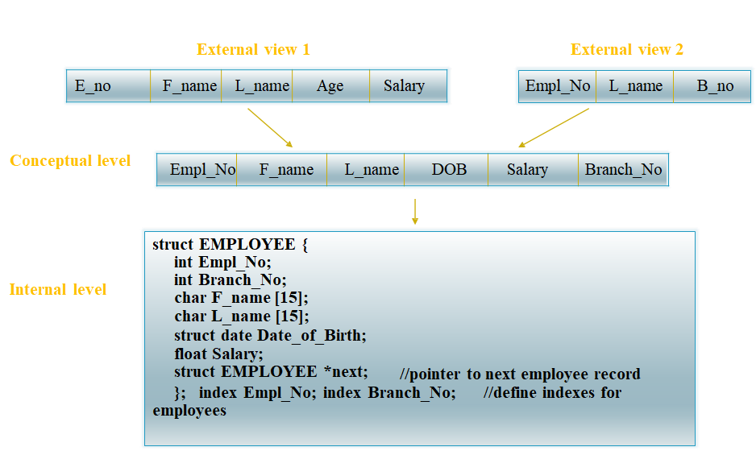
Three Levels of Architecture

Slide 25
Three Level Architecture Objectives
Each user should be able to access the same data but have a different customize view of the data.
User should not have to deal directly with physical database storage detail.
The DBA should be able to change the database storage structure without affecting the users views.

Slide 26
Three Level Architecture Objectives
The internal structure of the database should be unaffected by changes to the physical aspects of storage.
The DBA should be able to change the conceptual structure of the database without affecting all users.

Slide 27
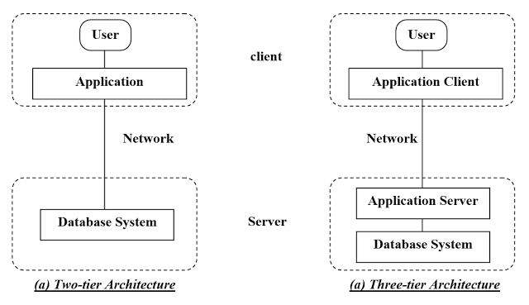
Two- tier and three tier architecture

Slide 28
History of Database Systems
1950s and early 1960s:
Data processing using magnetic tapes for storage
Tapes provided only sequential access
Punched cards for input
Late 1960s and 1970s:
Hard disks allowed direct access to data
Network and hierarchical data models in widespread use
Ted Codd defines the relational data model
Would win the ACM Turing Award for this work
IBM Research begins System R prototype
UC Berkeley (Michael Stonebraker) begins Ingres prototype
Oracle releases first commercial relational database
High-performance (for the era) transaction processing

Slide 29
History of Database Systems
1980s:
Research relational prototypes evolve into commercial systems
SQL becomes industrial standard
Parallel and distributed database systems
Wisconsin, IBM, Teradata
Object-oriented database systems
1990s:
Large decision support and data-mining applications
Large multi-terabyte data warehouses
Emergence of Web commerce

